Slide 1

35th International Physics Olympiad
Pohang, Korea
15 ~ 23 July 2004
Theoretical Question 2
Theoretical Competition
Saturday, 17 July 2004

Slide 2
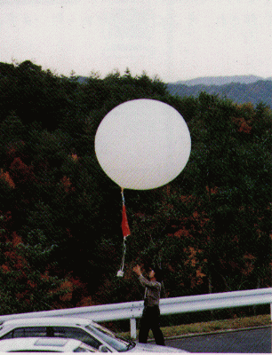
Theoretical Question 2:
“Rising Balloon”
Objective: To find out how high a balloon rises

Slide 3
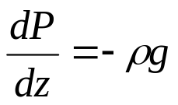
Theoretical Question 2:
“Rising Balloon”
Problem design:
Air
F_{B}=ρ_{air}Vg
He
ΔW=P_{diff}ΔV
F_{B}=M_{T}g
Payload

Slide 4

Theoretical Question 2:
“Rising Balloon”
Physical concepts required:
  Hydrodynamics
    Buoyancy
    Pressure
  Thermodynamics
    Ideal gas law
    1st Law of Thermodynamics
  Mechanics
    Energy and Work
    Force Equilibrium

Slide 5
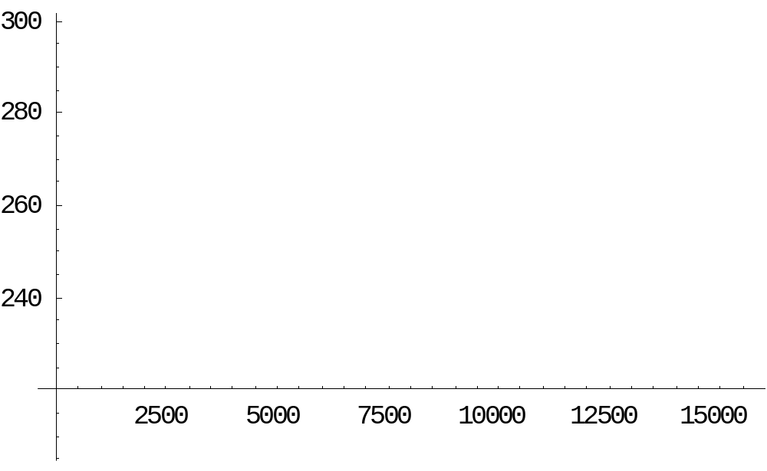
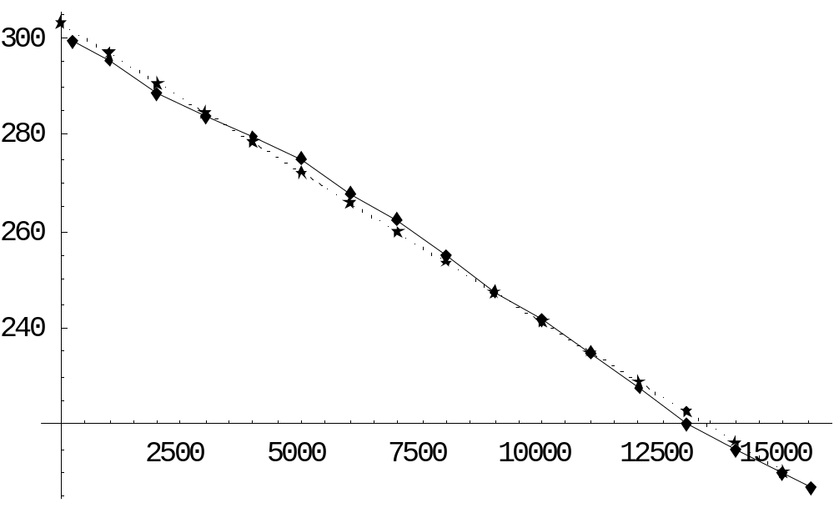
Theoretical Question 2:
“Rising Balloon”
Real data of temperature versus height
from a radiosonde flight on July 29, 1998
Linear fit of the temperature by 303(1-z/49000)

Slide 6
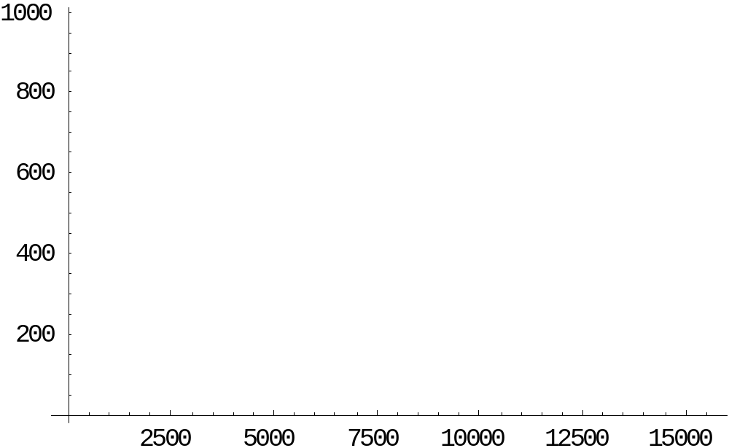
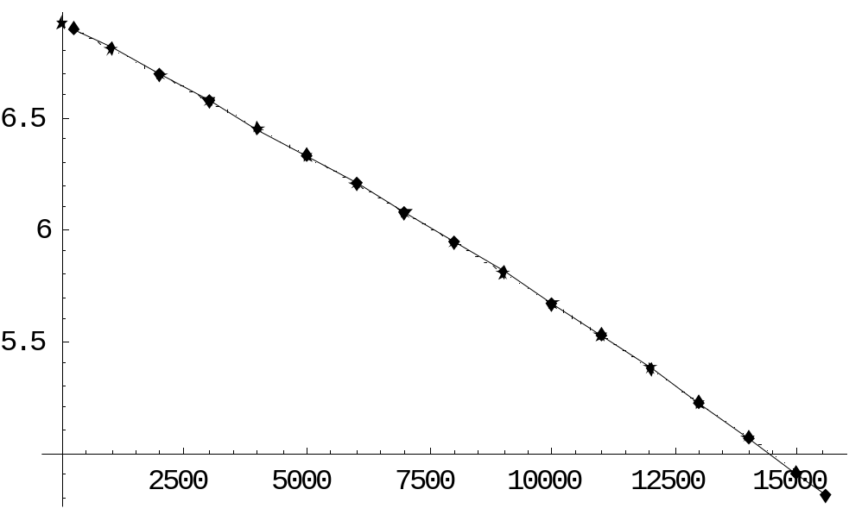
Theoretical Question 2:
“Rising Balloon”
Real data of pressure versus height on the same flight
Power law fit of the pressure data
by 1013.*(1-z/49000)5.5. Log of P versus z is shown

